Slide 1
Changing the Clinical Research Paradigm: Learning Health Systems and Pragmatic, Technology-Enabled Trials
Matthew T. Roe, MD, MHS
Senior Investigator
Duke Clinical Research Institute

Slide 2
What is a Learning Health Care System?
The Institute of Medicine’s Vision:
Research happens closer to clinical practice
Scientists, clinicians, and administrators work together
Studies occur in everyday practice settings
Electronic medial records are linked and mined for research
Recognition that health system data exist for the public good
Evidence informs practice and practice informs evidence

Slide 3
Principles for Conducting Pragmatic Clinical Trials in Learning Health Care Systems
10/2016
Leverage available medical data from electronic health records (EHRs) to identify potentially eligible patients
Recruit large samples of patients within healthcare systems to limit selection biases and provide more generalizable results that are relevant to routine practice
Simplify baseline and follow-up data collection through systematic direct patient contact and surveillance of multiple, electronic data sources
Ascertain endpoints as part of routine healthcare delivery and administrative claims retrieval

Slide 4
Framework for the Evolution of Pragmatic, Technology-Enabled Clinical Trials

Slide 5
Duke / DCRI Strategy for Real-World Data
Define a platform that leverages RWD to support the generation and dissemination of real-world evidence across a learning health system
Population health management, precision medicine, value-based care delivery, benchmarking, and quality improvement
Education and dissemination of evidence to patients and providers
Facilitation of pragmatic trials and observational research
Redesign traditional research processes and methods to take advantage of RWD – be deliberate in how to incorporate evolving data and technology approaches
Collaborate with industry partners to access, analyze, and leverage RWD sources from across the U.S. to transform and enhance the development and life cycle management of compounds in their portfolios

Slide 6
Using RWD (EHRs) to Enable Clinical Trials
Study Conduct
Recruitment
Study Setup
Data Collection
Trial-specific data capture embedded within EHR workflows
CRFs auto-populated with data from EHRs
Algorithms to identify RWD-based efficacy and safety outcomes Rules, Alerts & Checks
Data quality and completeness
Hospitalization/SAEs
Event rates
Participant Retention & Contact
Use of patient portals to collect PRO’s, share trial progress reports, and enhance retention
Pre-Study
Participant Enrollment
Develop EHR-based screening reports – contact potential participants or identify & recruit during clinics
Deploy provider-specific EHR alerts to identify eligible patients during care delivery
Use of patient portals (EHR-based and stand-alone) for patient outreach and electronic consent
Site Onboarding
Translate inclusion/exclusion criteria into an EHR-based reporting program (to identify eligible patients)
Feasibility dashboards
Embed encounter instructions into sites’ EHR systems
Pre-consent and study-specific consent
Model potential outcomes
Protocol Design
Characterize RWD-based outcomes & endpoints
Cohort Identification
RWD-compatible inclusion/exclusion criteria (computable phenotype)
Understand patient cohorts; interactions with health systems
Site Selection
Experience using RWD to facilitate research
Feasibility and recruitment plans

Slide 7
FDA Real World Evidence Framework and Transformation
Are data fit for use?
Does RWE answer regulatory questions?
Did study meet FDA regulatory requirements?
Establish demonstration projects
Stakeholder engagement
Develop guidance documents for using RWE
Setting data standards for RWD
RWD Fitness Assessment
Clinical study methodology and reliability
Data accrual and data quality control
Relevance of underlying data
Released by FDA in December, 2018

Slide 8
Quality by Design for Clinical Trials of the Future
Simple hypothesis that can be tested and addressed in a large and readily accessible patient population with high quality trial design, conduct, and execution
Patient-directed, patient-centric approach
The definition of a quality technology-enabled, pragmatic trial requires
Appropriate engagement and randomization of a diverse, representative patient population
Confirmed receipt of and compliance/adherence with the randomized treatment or intervention
Complete ascertainment and evaluation of all potential efficacy and safety events
Identification of any major GCP issues

Slide 9
ADAPTABLE – A Case Study for Network-Based Pragmatic Trials

Slide 10
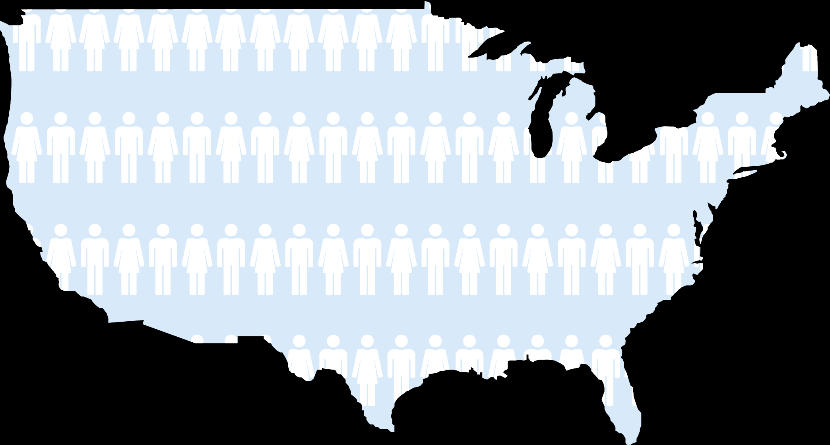
PCORnet: A National Evidence System 110 Million patients in 64 Health System Data Marts
Sex
Female
Male
Race
White
Non-White
Age
0–4
5–14
15–21
22–64
65+
Pool of patients
For clinical trials
33,179,287
For observational studies
68,640,564
Notes:
PCORnet currently has approximately 110 million people’s data available to researchers.
We can drill down and take a closer look at how that breaks down…
By sex
By pool of patients for observational studies or clinical trials
By age
And by race

Slide 11
PCORNet Research Network – Uniting Data from Patients, Clinicians, Health Systems
Notes:
This data is a result of partnerships and collaborations between researchers, patients, clinicians, health systems, and data sources. The information that is available in the Network on the approx. 110M patients comes from a variety of data sources.

Slide 12
ADAPTABLE Study Design
15,000 patients with known ASCVD + ≥ 1 Enrichment Factor
Patients identified by research networks in PCORnet through EHR/CDM searches using a computable phenotype that classifies inclusion/exclusion criteria
Patients provided with trial information and link to e-consent on a web portal;†
Randomized treatment assignment provided directly to patient
ASA 81 mg QD
ASA 325 mg QD
Electronic patient follow-up for PRO’s: Every 3 or 6 months Supplemented with searches of EHR and claims data
Duration: Enrollment over ~ 3 years; maximum follow-up of ~ 4 years
† Participants without internet access will be consented and followed via a parallel system.
Primary Efficacy Endpoint: Composite of all-cause mortality, hospitalization for MI, or hospitalization for stroke
Primary Safety Endpoint: Hospitalization for major bleeding
ClinicalTrials.gov: NCT02697916

Slide 13
ADAPTABLE Inclusion Criteria – Computable Phenotype
Known ASCVD
Prior MI
OR
Prior revascularization (PCI or CABG)
OR
Prior angiogram showing significant CAD
OR
History of chronic ischemic heart disease, CAD, or ASCVD
≥ 1 enrichment factor:
Age ≥ 65 years
Creatinine ≥ 1.5 mg/dL
Diabetes mellitus
Known 3-vessel CAD
Cerebrovascular disease
Peripheral arterial disease
Current smoker
Known LVEF < 50%
Chronic systolic or diastolic heart failure
SBP ≥ 140 (within past 12 mos)
LDL ≥ 130 (within past 12 mos)
Electronic Patient Outreach
ClinicalTrials.gov: NCT02697916

Slide 14
Electronic-Facilitated Recruitment Approach in ADAPTABLE
Electronic, computable phenotype used to query EHR data to facilitate widespread screening of large numbers of potentially eligible patients
Patient Outreach and Recruitment Approaches
Direct Mail and Email (messages locally customized with input from patient representatives)
Via health system patient portals such as “MyChart”
“In-Clinic” Recruitment (EHR Alerts to clinic providers, Tablet-based recruitment during clinic encounters, promotion of trial during clinic)
Potential patients given Golden Ticket numbers and directed to the Adaptable web portal for confirmatory screening and electronic, web-based informed consent
ClinicalTrials.gov: NCT02697916

Slide 15
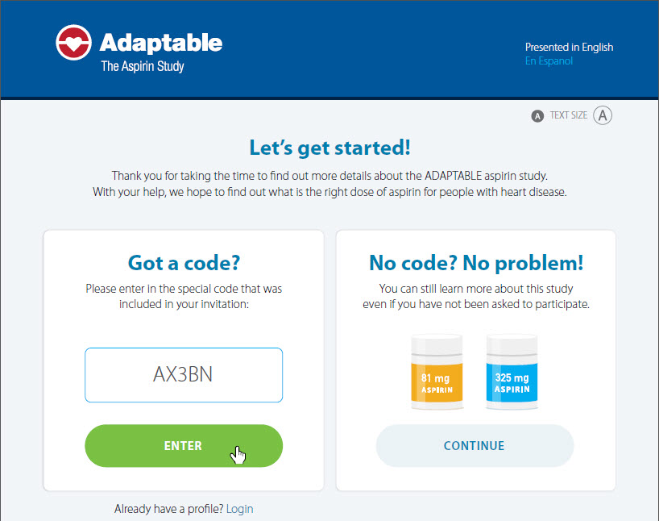
www.adaptablepatient.com
ClinicalTrials.gov: NCT02697916

Slide 16
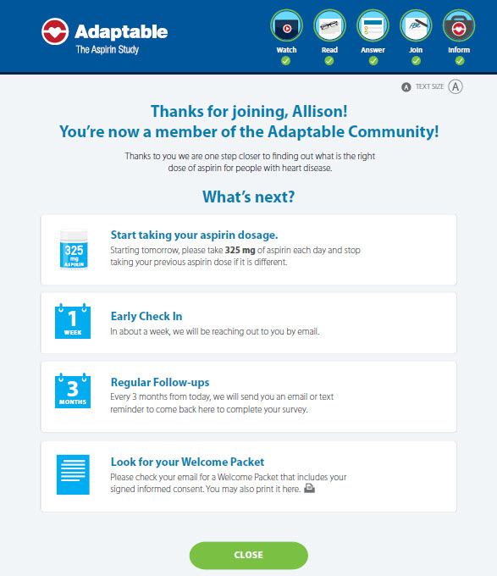
Web-Based Randomization
10/2016
Randomized treatment assignment (aspirin dose) provided directly to patients after informed consent
Reminders for electronic follow-up contacts given at time of randomization
Patients randomized to follow-up contacts every 3 months vs. 6 months
Embedded feature

Slide 17
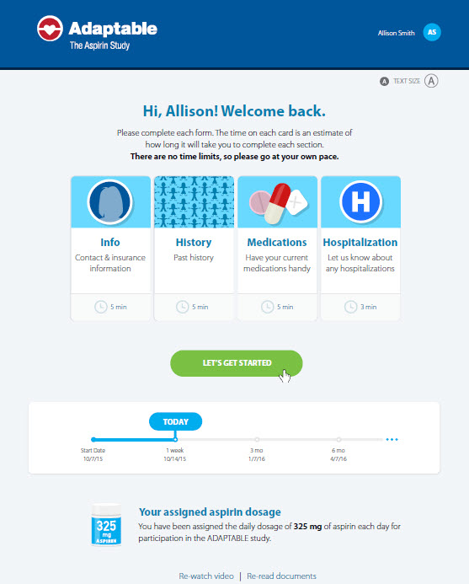
Direct-to-Patient Follow-Up
10/2016
Patients receive email reminders to visit web portal for regular contacts every 3 vs. 6 months
Central DCRI Call Center performs telephone contacts when needed
Non-internet participants (20%)
Participants who miss at least 2 scheduled electronic contacts

Slide 18
Longitudinal Endpoint Ascertainment
Quarterly queries of the PCORnet common data model (CDM) to capture and classify endpoints
Hospitalizations identified via standardized, validated coding algorithms developed centrally and applied to the CDM
ADAPTABLE web portal will be used to collect possible events (hospitalizations for MI, stroke, or major bleeding) during patient electronic or telephone contacts (every 3–6 months)
Patient-reported outcomes (PRO’s) are cross-checked and verified with the CDM-generated hospitalization data
Surveillance of CMS and private health plan data for potential “out-of-network” hospitalizations
Medical records obtained for PRO’s not classified through other means
Death ascertainment via CDM, Social Security Administration (Medicare beneficiaries), and Call Center contacts for patients with missed visits
Notes:
LHC: Red text is not what we describe in the protocol (copied in below). We need to be consistent.
Endpoints will be ascertained by applying algorithms designed to ensure comprehensive surveillance for all potential endpoints.
•Routine queries will be applied to the PCORnet CDM to capture and classify endpoints using validated coding algorithms. Because the EHR and (by extension) the PCORnet CDM is the source of truth for the trial, no patient confirmation or other additional confirmation will be required.
•Hospitalizations for stroke, MI, or bleeding reported by patients will be evaluated in the following manner:
oQueries of the PCORnet CDM will be used to cross-check, confirm, and classify in-network hospitalizations (nonfatal MI, nonfatal stroke, or major bleeding) reported by patients.
oOut-of-network hospitalizations reported by patients and not captured in the CDM will be identified by patient self-report through the periodic electronic contacts planned throughout the study.

Slide 19
Challenges with EHR-Enabled Trials
Accuracy, timeliness, and completeness of EHR data sources
Lack of interoperability of EHR systems requiring multiple different technical approaches to aggregate data from diverse sources
Lack of widespread implementation and updating of data standards
Data provenance and security concerns within and across countries
Highly variable site/health system expertise with leveraging local EHR data for purposeful pragmatic clinical research activities

Slide 20
Building Site and Data Networks for for Pragmatic Trials in the U.S.

Slide 21
Informatics Solutions for Pragmatic Trials: Developing EHR-based Clinical Research Networks
Trial-Specific Clinical Research Network
Research Site A
EHR
Internal Data Warehouse
Research
Datamart
EHR
Internal Data Warehouse
Research Datamart
Integrated
Clinical Trial Database
Research Site B
EHR
Data Warehouse
Research Datamart
Research Site C
Centralized disease registry
EHR data can auto-populate part of the trial database

Slide 22
Approaches for Obtaining EHR Data for Trials (1)
Distributed Research Network
Send query to sites who have data in pre-existing format (common data model data standards)
Sites return results (e.g., aggregate counts, summary statistics, patient-level records, etc)
EHR
CDM
1 – Distribute Queries
2 – Receive Output
Study-Specific Database
Analysis

Slide 23
Approaches for Obtaining EHR Data for Trials (2)
Centralized Transformation
Sites send “raw” EHR data to central coordinating center from their local EHR databases or common data models
Study coordinating center transforms raw EHR data into target format and runs analyses
EHR
DB 1
Extract 1
EHR
CDM 2
Extract 2
Study-Specific Database
EHR
DB 3
Extract 3
Analysis
EHR
CDM X
Extract X

Slide 24
Assessing EHR Data Quality
When receiving data from the EHR (or claims or any other source), important to continuously monitor the quality of the incoming data
EHR data quality domains ascertained:
Conformance – are EHR data formatted correctly?
Completeness – are EHR data present when we expect them to be?
Plausibility – do the values of the data elements make sense?
Data checks should be based on use-case scenarios
Need to consider point-in-time metrics as well as rates over time
Compare within-site metrics, as well as across-site metrics
Essential to connect back to sites/health systems on a regular basis to improve EHR data quality and address questions

Slide 25
Envisioning the Future

Slide 26
Data Flow and Data Integration with Multiple, Novel Electronic Data Sources
Sites/Health Systems
EDC
IBM CD / RAVE
Data Coordinating
Center
Trial
Sponsor
EHR
EHR
Integrated Study Database
Study Dataset
EDC
Call Ctr
Safety DB
SDTM+
Patients/Participants
CEC DB
Phone
Device Stream
Reporting,
Analysis,
Publication
Analysis, FSR, Submission
App
Claims Stream
Devices
…

Slide 27
RWD Lessons Learned
Field of RWD-enabled research is dynamic and changing rapidly
What is impossible today may become easy tomorrow
Any given technology or data approach may soon become obsolete
No single turn-key solution exists for RWD access, collection, and analysis
Leverage experience with diverse RWD sources (EHR, PRO’s, administrative claims, etc.) to create a nimble and “fit-for-purpose” data solution for each study
Focus upon translating ongoing “lessons learned” into tangible plans for developing flexible and reusable infrastructure for future use
Need to understand site/health systems capabilities (data, IT, research)
Type, format, and structure of RWD (EHR, claims) used for care delivery, population health management, and research
Personnel resources – informatics, data science, IT, coordinators, investigators
Provide training and education around best practices for leveraging RWD

Slide 28
Cross-Sectional Stakeholder Partnerships Needed

Slide 29
Pragmatic Trials in Learning Health Systems
Pragmatic, simple trials can be successfully executed within learning health systems across the United States
Strong collaborations needed among clinicians, research personnel, data scientists, technology experts, and informatics experts
Use of RWD and technology advances to facilitate trial execution will drive future transformation but nimble, flexible approaches needed to ensure trial quality standards are achieved
Iterative systems needed to maximize efficiency and data capture
All clinical trial stakeholders embrace pragmatic trials
Learning curve is steep and open sharing of lessons learned is essential to optimize collaborations and development of research networks capable of conducting trials of the future

